Slide 2
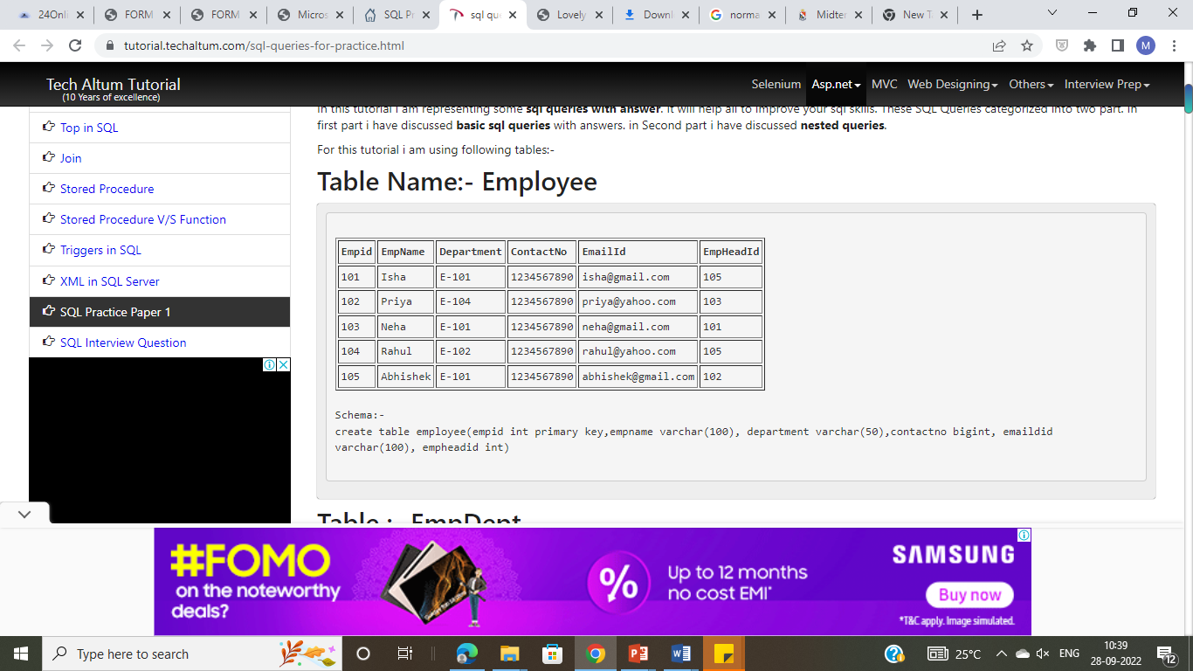
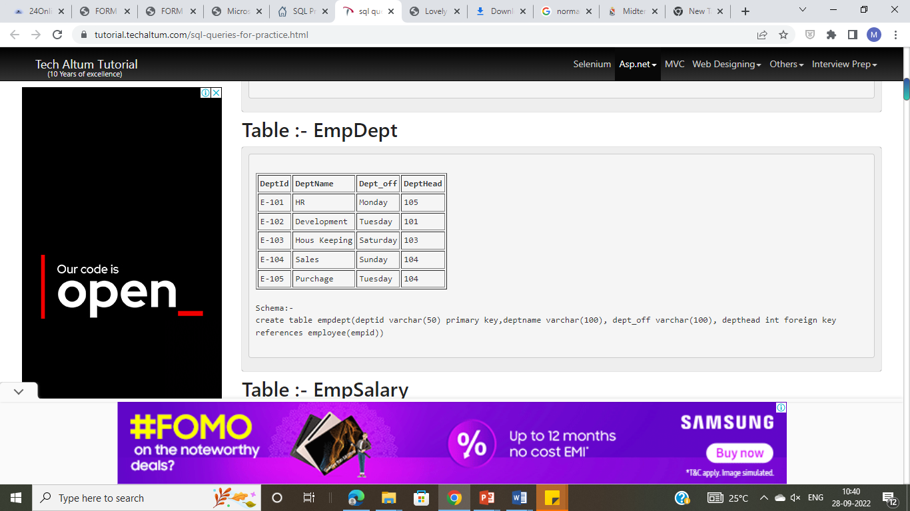

Slide 3
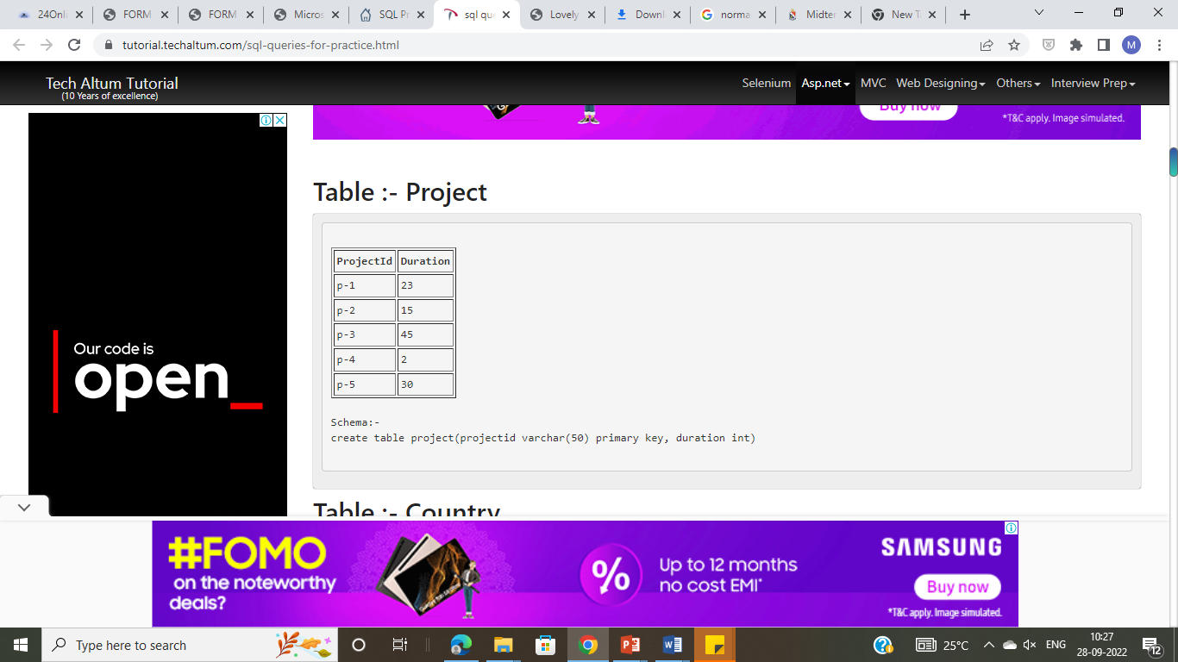
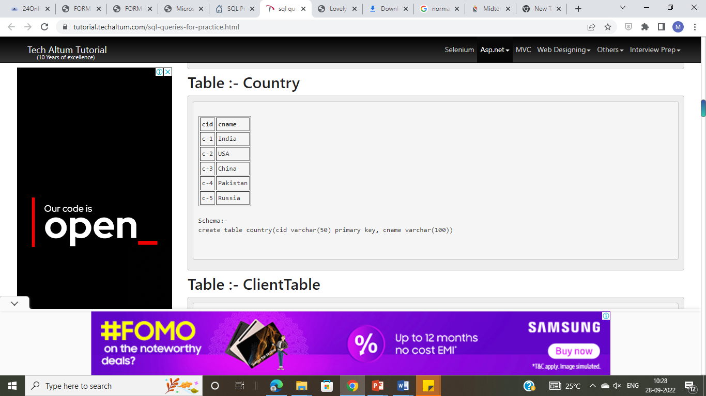

Slide 4

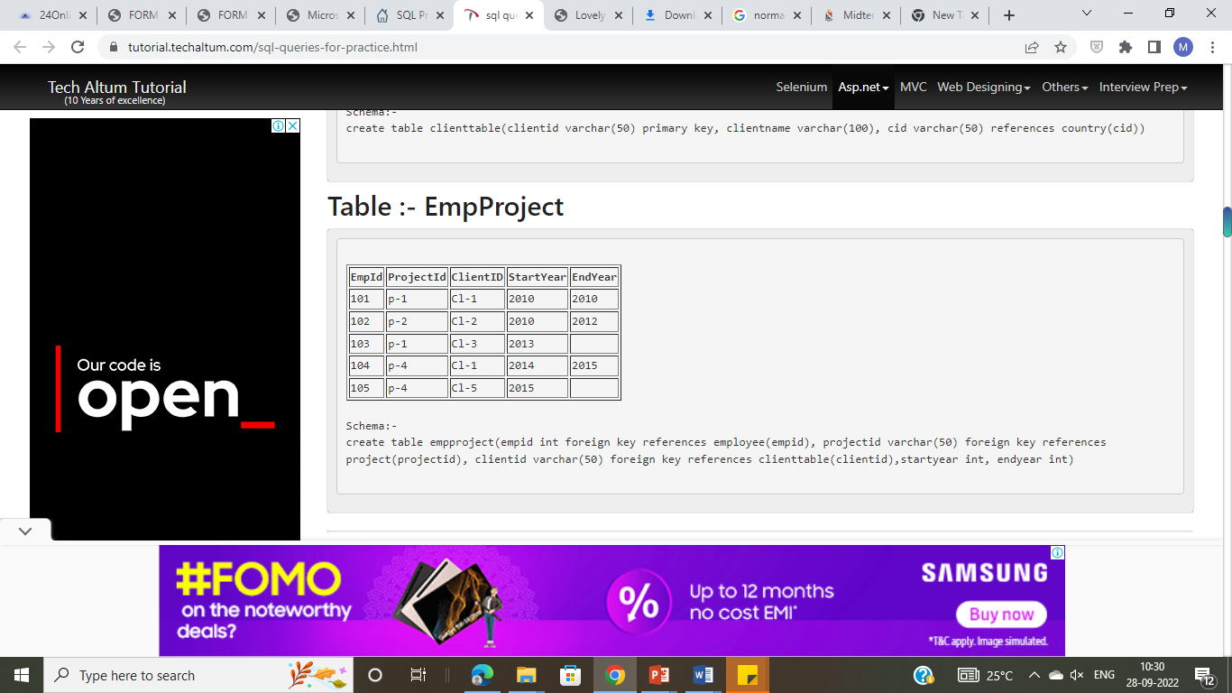

Slide 5
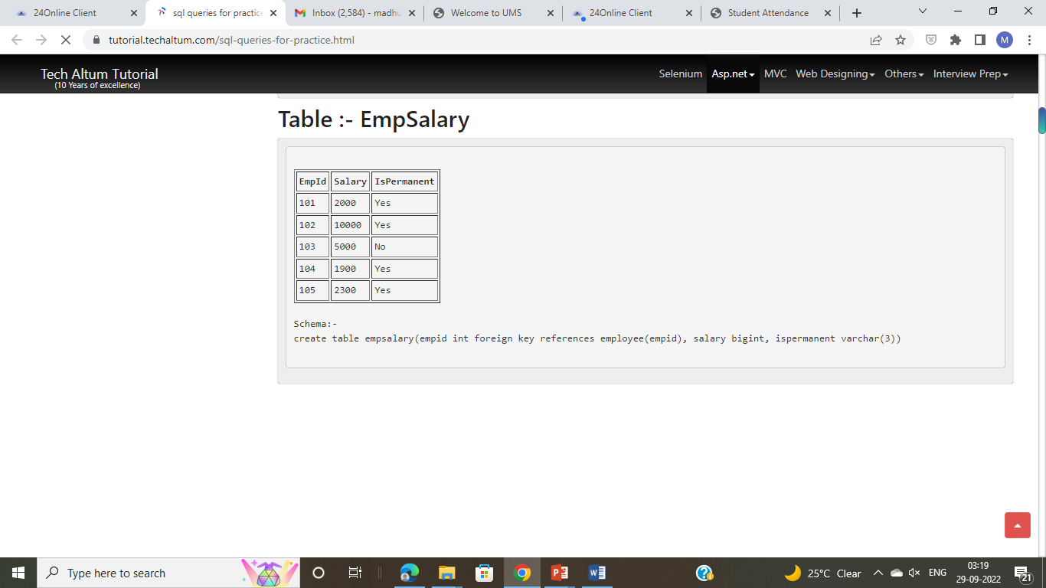

Slide 6
1. Select the detail of the employee whose name start with P.
2. How many permanent candidate take salary more than 5000.
3. Select the detail of employee whose emailId is in gmail.
4. Select the details of the employee who work either for department E-104 or E-102.
5. What is the department name for DeptID E-102?
6. What is total salarythat is paid to permanent employees?
7. List name of all employees whose name ends with a.
8. List the number of department of employees in each project.
9. How many project started in year 2010.
10. How many project started and finished in the same year.
11. select the name of the employee whose name's 3rd charactor is 'h'.

Slide 7
1. Select the department name of the company which is assigned to the employee whose employee id is greater 103.
2. Select the name of the employee who is working under Abhishek.
3. Select the name of the employee who is department head of HR.
4. Select the name of the employee head who is permanent.
5. Select the name and email of the Dept Head who is not Permanent.
6. Select the employee whose department off is Monday
7. select the indian clinets details.
8. select the details of all employee working in development department.

